Slide 1
Forecast of International Visitors/$ Returning YE May 2022-2025
TECNZ’s arrival and visitor spend forecasts for 30 countries based on research and assumptions noted below. The forecasts form a roadmap for NZ’s international tourism recovery on a market basis and are based on no self-isolation requirement for visitors.
Assumptions:
Airline connectivity, capacity seats and IATA forecasts
NZ Airport SABRE bookings
Demand from offshore tour wholesalers/agents
Booking levels held by inbound tour operators (ITOs)
High booking level from Australia, US for 23-24 season
FIFA Women’s World Cup games Feb, Jul-Aug 2023
Return of cruise by Oct 2022 (turnaround pax)
Slow visitor visa processing times, losing business
WHV holders return to NZ
China market return from Oct 2023 (estimate)
Russia-Ukraine War and Europe energy crisis
Displaced visitor flow from Europe to NZ
Geo-political/economic status in source markets e.g. worker shortage, inflation and wage rates
Higher airfares to NZ beyond 2023
All NZ border travel restrictions lifted by Oct 22
Visitor Market Return:
Australia from 13 April 2022
USA/Canada from July 2022
UK/Europe from Oct 2022
Asia from Oct 2022
China from Oct 2023
NZ visitor season starts 1 Oct 2022 and runs to 30 April 2023.
2022-2025
Spreadsheets showing return on a per country basis over 4 years are available on our website or contact our office.
Source: TECNZ updated 22 November 2022

Slide 2
Summary: Forecast of International Visitors/$ Returning YE May 2022-2025
Key message
The return of pre-COVID visitor numbers and spend will be a phased process over a period of 3 years.
By YE May 2025 TECNZ forecasts 98.7% of annual arrivals will return.
Arrivals (000’s):
By YE May 2023 annual number of arrivals 2,134,802 = 63.1%
By YE May 2024 annual number of arrivals 2,900,284 = 85.9%
By YE May 2025 annual number of arrivals 3,283,746= 98.7%
Visitor Spend ($M):
By YE May 2023 annual visitor spend $7,799 billion = 57%
By YE May 2024 annual visitor spend $11,300 billion = 83%
By YE May 2025 annual visitor spend $13,298 billion = 97%
TECNZ has forecast annual visitor arrivals and visitor spend on the key 30 visitor markets Stats NZ used to report on pre-COVID March 2020.
We have added 12% to pre-Covid visitor spend ($) levels across most markets to factor in higher saving rates and longer length of stay trends. China as a high spend market and its slow recovery rate may prevent annual visitor spend exceeding pre-Covid levels in the next 1-2 years.
Source: TECNZ updated 22 November 2022

Slide 3
NZ International Tourism Recovery Roadmap (No. Arrivals 000’s and % Recovery) Market recovery based on Australia from April 2022, USA from July 2022, UK/Europe from Oct 2022, Asia from Oct 2022 and China from Oct 2023 By YE May 2025, total annual visitor arrivals 98.7% of pre-COVID arrivals Mar 2020 (3,283,746). Long-haul markets travel from 1 Oct for a NZ season
May 22
May 23
May 24
May 25
Pre COVID
Assumptions:
Airline connectivity, seats and IATA forecasts
NZ Airport SABRE bookings
Demand from offshore tour wholesalers/agents
Slow visitor visa processing times, losing business
WHV holders return to NZ
China airline re-connectivity
Russia-Ukraine War and Europe energy crisis
Displaced visitor flow from Europe to NZ
FIFA Women’s World Cup games Feb, Jul-Aug 2023
Return of cruise by Oct 2022 (turnaround pax)
Geo-political/economic status in source markets e.g. worker shortage, inflation, wage rates
All NZ border travel restrictions lifted by Oct 22
Australia
USA
China
UK
Germany
Japan
South Korea
India
Singapore
Taiwan
Hong Kong
France
The Netherlands
1,491,252
(15%)
223,688
(80%)
1,193,002
(95%)
1,416,689
(100%)
1,491,252
347,629
(0%)
0
(80%)
278,103
(100%)
347,629
(115%)
399,773
328,145
(0%)
0
(0%)
0
(50%)
164,073
(85%)
295,331
223,102
( 0%)
0
(75%)
167,327
(90%)
200,792
(100%)
223,102
91,067
( 0%)
0
(70%)
63,747
(90%)
81,960
(100%)
91,067
(75%)
90,326
( 0%)
0
(30%)
27,098
(75%)
67,745
(95%)
85,810
81,660
(0%)
0
(30%)
24,498
(75%)
61,245
(95%)
73,494
67,395
(0%)
0
(40%)
26,958
(70%)
47,177
(85%)
57,286
60,932
(0%)
0
(80%)
48,746
(100%)
60,932
(100%)
60,932
49,179
(0%)
0
(40%)
19,672
(70%)
34,425
(90%)
44,261
51,807
( 0%)
0
(40%)
20,723
(70%)
36,265
(90%)
46,626
39,507
( 0%)
0
(75%)
29,630
(90%)
35,556
(100%)
39,507
29,384
( 0%)
0
(75%)
22.038
(85%)
24,976
(100%)
29,384
Source: TECNZ Forecast based on Stats NZ IVA Top 30 Countries Annual International Arrivals as at YE March 2020, updated 22 November 2022
24,863

Slide 4
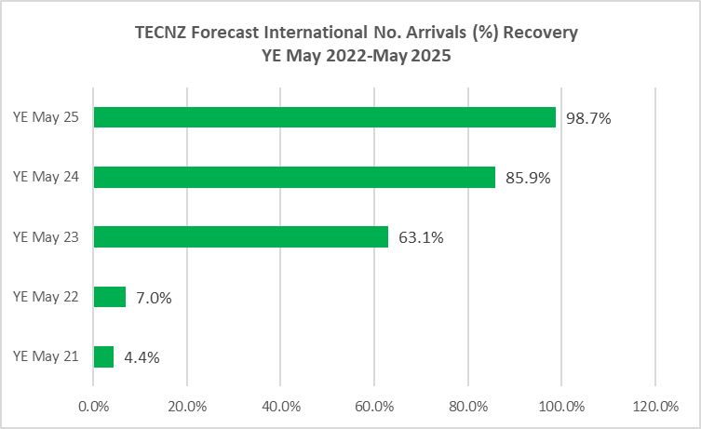
3,339,444
2,907,630
2,134,802
Arrivals:
Australia from Apr 2022
USA from July 2022
UK/Europe from Oct 2022
Asia from Oct 2022 (excludes China)
China from Oct 2023
235,499
Source: TECNZ Forecast based on Stats NZ IVA Top 30 Countries Annual International Arrivals as at YE March 2020, updated 22 November 2022

Slide 5
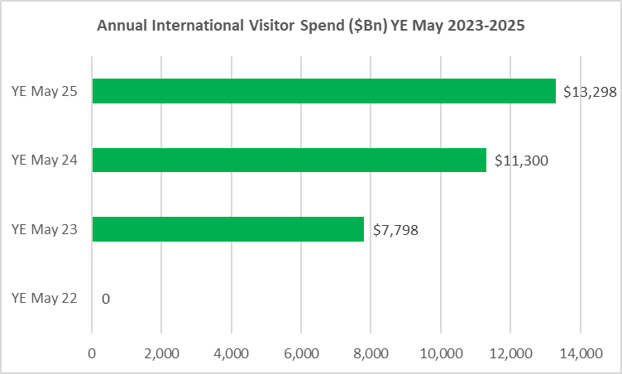
97%
83%
YE Mar 2020 total visitor spend approx. $12,194m
Increase in spend due to longer stay, higher spend trends, noting China spend not factored in till Oct 2023 so it would be higher if China travel was in the mix.
57%
Source: TECNZ Forecast based on Stats NZ IVA Top 30 Countries Annual International Arrivals as at YE March 2020, updated 22 November 2022

